Slide 1
Data Mining To Classify Telco Churners
Mohit Mhapuskar
Guided by Prof. Mahmoud Daneshmand

Slide 2
Introduction
In the modern world, almost all the civilized population subscribe to a telecommunications provider for their cellular connections, internet connections, landline, television connection etc.
However, many customers often switch or unsubscribe (churn) from their telecom providers for a variety of reasons. These could range from unsatisfactory service, better pricing from competitors, customers moving to different cities etc.
Therefore, telecom companies are interested in analyzing the patterns for customers who churn from their services and use the resultant analysis to determine in the future which customers are more likely to unsubscribe from their services. One such company is Telco Systems. Telco Systems is interested in identifying the precise patterns for their churning customers and have provided the customer data for this project.

Slide 3
Standard Industry Process : CRISP -DM
Business Understanding
Data Understanding
Data Preparation
What is the business objective? Define the problem statement. Produce a project plan.
Description of the dataset and its attributes. Preliminary exploration of data.
Clean data of missing values and outliers. Perform any necessary transformation to prepare data for analysis.
1
2
3
Modeling
Evaluation
Deployment
Select data modeling technique and generate model. Optimize model and perform assessment.
Evaluate results of model. Determine accuracy of model. Discuss next steps.
Generate final project report. Deploy model in Industry sector.
4
5
6

Slide 4
Business Understanding

Slide 5
Business Understanding
What is the profound question?
Whether a subscriber will churn from the telecom service or not?
What is the project goal?
Use data mining techniques such as classification algorithms to determine whether customers will churn or not churn and generate the classification rules accordingly.
What is the business implication?
The generated rules will allow Telco systems to understand the factors as to why customers may churn from their service. It will also enable them to modify their business practices accordingly, to reduce the number of churning customers in the future.

Slide 6
Data Understanding

Slide 7
Data Understanding
Data Source
The data provided by Telco Systems contains the customer churn records in the span of one month. Dataset was obtained from www.Kaggle.com.
Dataset Details
The raw dataset comprises 7043 records of customers along with 21 attributes. 20 of these attributes are independent attributes.
Target Attribute
The target attribute is the one that classifies the subscribers as having churned from the service or not.

Slide 8
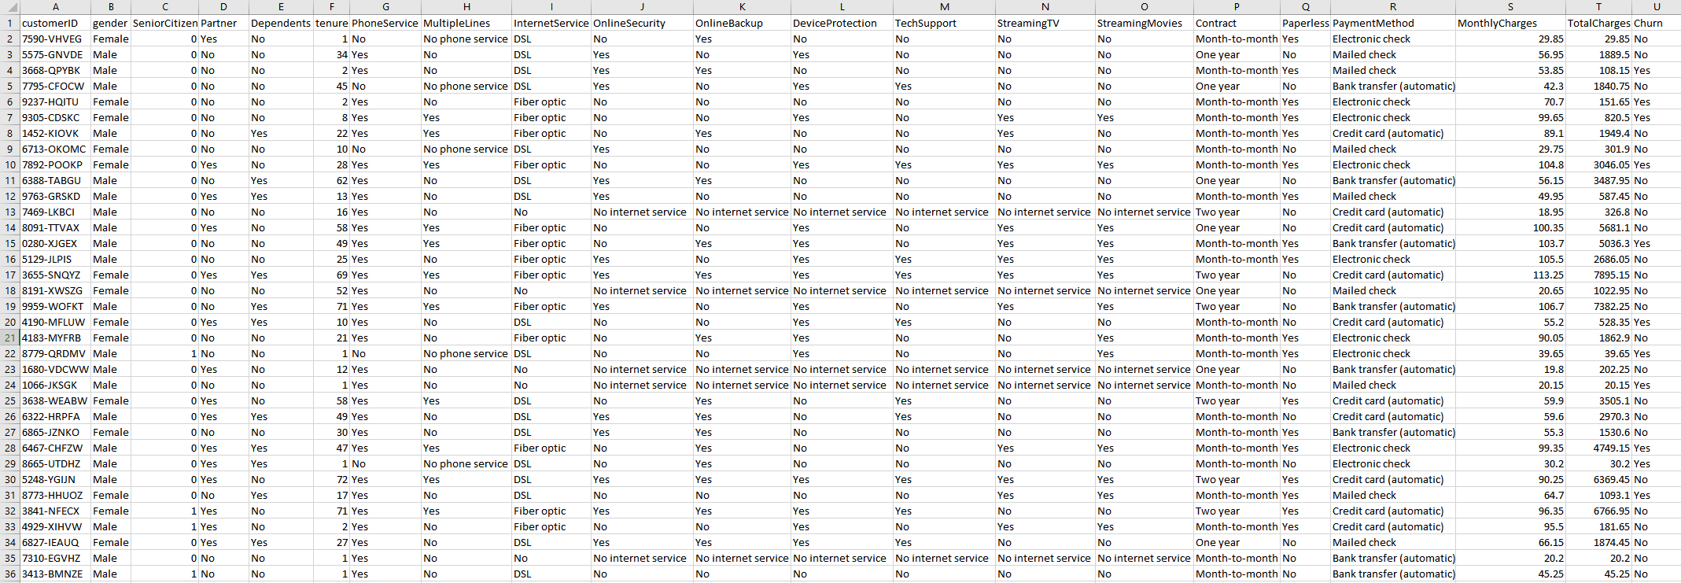
Data Understanding
Dataset Sample

Slide 9
Data Understanding
Understanding the attributes
CustomerID: Company assigned ID (Unique Primary Identifier).
Gender: Customer gender (Female, Male).
SeniorCitizen: Whether the customer is senior citizen (1, 0).
Partner: Whether the customer has a partner (Yes, No).
Dependents: Whether the customer has dependents (Yes, No).
Tenure: No. of months customer has stayed with the company (Continuous Variable).
PhoneService: Whether the customer has phone service (Yes, No).
MultipleLines: Whether the customer has multiple lines (Yes, No, No Internet Service).
InternetService: Type of customer’s Internet service (DSL, Fiber Optic, No).
OnlineSecurity: Whether the customer has internet service security (Yes, No, No Internet Service).
OnlineBackup: Whether the customer has online backup plan (Yes, No, No Internet Service).

Slide 10
Data Understanding
DeviceProtection: Whether the customer has internet device protection (Yes, No, No Internet Service).
TechSupport: Whether the customer has tech support (Yes, No, No Internet Service).
StreamingTV: Whether the customer has streaming TV (Yes, No, No Internet Service).
StreamingMovies: Whether the customer has streaming movies (Yes, No, No Internet Service).
Contract: The contract term of the customer (Month-to-Month, One Year, Two Year).
PaperlessBilling: Whether customer has paperless billing (Yes, No).
PaymentMethod: Customer’s payment method (Electronic check, Mailed check, Bank transfer (automatic), Credit card (automatic) ).
MonthlyCharges: Customer’s monthly charges (Continuous Variable).
TotalCharges: Customer’s total charges (Continuous Variable).
Churn: Whether customer churned or not (Yes, No) (Target Variable).

Slide 11
Data Preparation

Slide 12
Data Preparation
In this phase the dataset will be cleaned and transformed to prepare it accordingly for analysis. Data preparation may involve any of the 3 following operations.
1
Handle Missing Values & Outliers If Needed
2
Perform Attribute Transformations If Needed
3
Select Appropriate Variables for Analysis

Slide 13
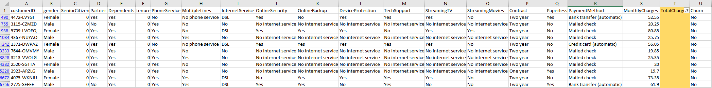
Data Preparation
Handling Missing Values
The dataset has missing values for 11 records in the attribute TotalCharges as shown below. Since there are only 11 such records out of a total of 7043, we can safely eliminate these records from our dataset without impacting the overall accuracy of our model.

Slide 14
Data Preparation
Identifying Outliers
The dataset was checked for outliers. There were no outliers detected in the dataset.
Attribute Selection
All the independent variables were deemed important in classification. All the attributes contribute toward the final target variable i.e. whether a customer churns or not.
The final list of variables is therefore: gender, SeniorCitizen, Partner, Dependents, Tenure, PhoneService, MultipleLines, InternetService, OnlineSecurity, OnlineBackup, DeviceProtection, TechSupport, StreamingTV, StreamingMovies, Contract, PaperlessBilling, PaymentMethod, MonthlyCharges, TotalCharges.

Slide 15
Data Preparation
Data Division
The final transformed dataset consisting of 7033 records will be split into 2 subsets.
Training Dataset
The Training Dataset will be used to generate our model. 80% of the data i.e. about 5626 records will be used for training.
Test Dataset
The model generated using the training dataset will be applied to the test dataset to evaluate and test the accuracy of the model. 20% of the data i.e. the remaining 1407 records will be used for testing.

Slide 16
Modeling

Slide 17
Modeling
Now that we have prepared the data for analysis, the next phase begins with the selection of an appropriate data modeling technique. We will use one of the Machine Learning algorithms taught in this course for our project.
Since the main goal of this project is to classify the telecom service subscribers as Churners and Non-Churners, Recursive Partitioning is ideal since it recursively splits the data at each node into subsets resulting in a decision tree.
As the target variable is a binary categorical variable (Churn – Yes or No), Classification trees will be most appropriate for this dataset.
We conclude that the Classification and Regression Trees or CART algorithm is the most optimal solution for this project.

Slide 18

Modeling
Modeling Software
KNIME is a free and open-source data analytics, reporting and integration platform. KNIME integrates various components for machine learning and data mining through its modular data pipelining concept.
We will use the KNIME software and its in-built modules to import the dataset, split the dataset, generate our CART decision tree along with its decision rules and test the accuracy of the model on the test dataset using its in-built scorer.
Software obtained from https://www.knime.com/knime-software/

Slide 19
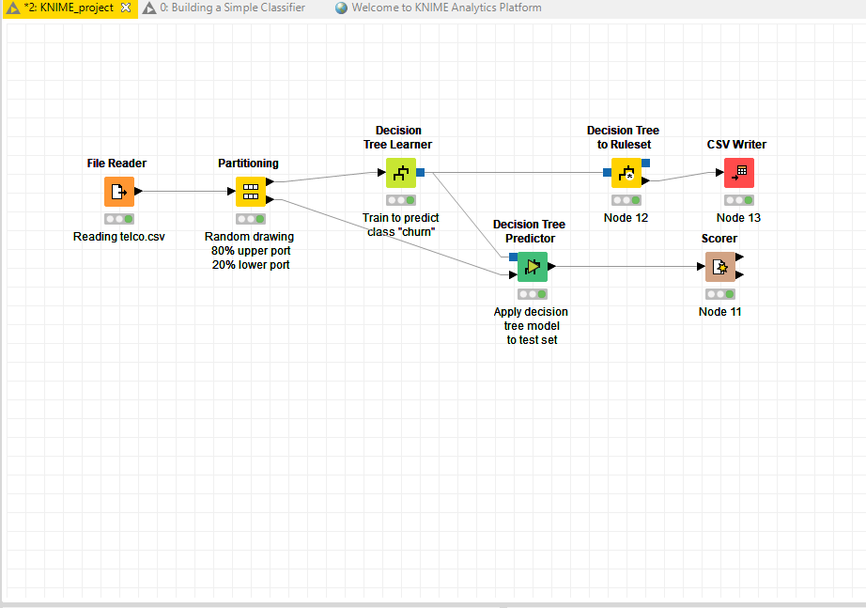
Modeling
Process Workflow
File Reader Imports Dataset
Partitioner splits into 80% Training and 20% Test Data.
Decision Tree Learner generates CART Tree.
Decision Tree Predictor applies model to test dataset.
Ruleset is generated and written.
The Scorer evaluates accuracy of the model.

Slide 20
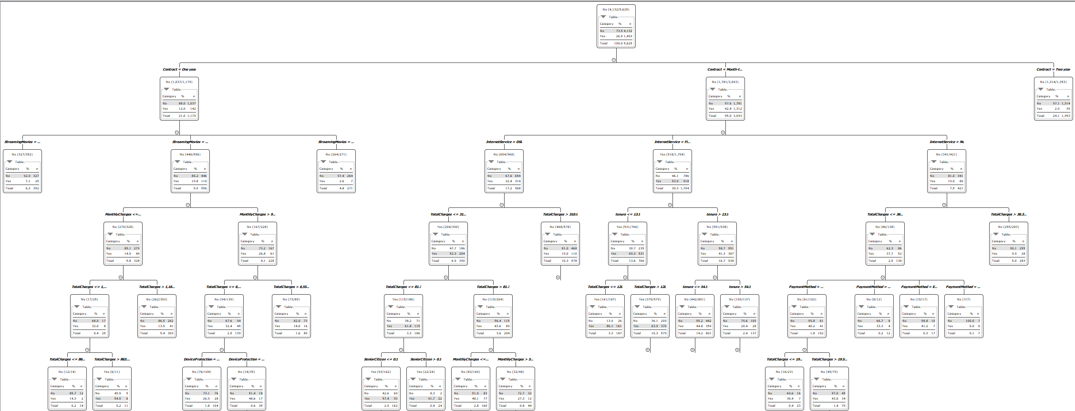
Modeling
CART Decision Tree

Slide 21
Modeling
Generated Decision Rules
Antecedent | Consequent
$StreamingMovies$ = No AND $Contract$ = One year | No
$TotalCharges$ <= 863.55 AND $TotalCharges$ <= 1166.35 AND $MonthlyCharges$ <= 99.85 AND $StreamingMovies$ = Yes AND $Contract$ = One year | No
$TotalCharges$ > 863.55 AND $TotalCharges$ <= 1166.35 AND $MonthlyCharges$ <= 99.85 AND $StreamingMovies$ = Yes AND $Contract$ = One year | Yes
$PaymentMethod$ = Mailed check AND $DeviceProtection$ = Yes AND $TotalCharges$ <= 6552.75 AND $MonthlyCharges$ > 99.85 AND $StreamingMovies$ = Yes AND $Contract$ = One year | No
$PaymentMethod$ = Bank transfer (automatic) AND $DeviceProtection$ = Yes AND $TotalCharges$ <= 6552.75 AND $MonthlyCharges$ > 99.85 AND $StreamingMovies$ = Yes AND $Contract$ = One year | No
$OnlineSecurity$ = Yes AND $PaymentMethod$ = Electronic check AND $DeviceProtection$ = Yes AND $TotalCharges$ <= 6552.75 AND $MonthlyCharges$ > 99.85 AND $StreamingMovies$ = Yes AND $Contract$ = One year | No
21

Slide 22
Modeling
Generated Decision Rules
Antecedent | Consequent
$TechSupport$ = No AND $OnlineSecurity$ = No AND $PaymentMethod$ = Electronic check AND $DeviceProtection$ = Yes AND $TotalCharges$ <= 6552.75 AND $MonthlyCharges$ > 99.85 AND $StreamingMovies$ = Yes AND $Contract$ = One year | No
$TechSupport$ = Yes AND $OnlineSecurity$ = No AND $PaymentMethod$ = Electronic check AND $DeviceProtection$ = Yes AND $TotalCharges$ <= 6552.75 AND $MonthlyCharges$ > 99.85 AND $StreamingMovies$ = Yes AND $Contract$ = One year | Yes
$Partner$ = No AND $OnlineBackup$ = Yes AND $DeviceProtection$ = No AND $TotalCharges$ <= 6552.75 AND $MonthlyCharges$ > 99.85 AND $StreamingMovies$ = Yes AND $Contract$ = One year | No
$Partner$ = Yes AND $OnlineBackup$ = Yes AND $DeviceProtection$ = No AND $TotalCharges$ <= 6552.75 AND $MonthlyCharges$ > 99.85 AND $StreamingMovies$ = Yes AND $Contract$ = One year | Yes
$MonthlyCharges$ <= 29.497 AND $PaperlessBilling$ = No AND $SeniorCitizen$ <= 0.5 AND $TotalCharges$ <= 81.7 AND $TotalCharges$ <= 310.9 AND $InternetService$ = DSL AND $Contract$ = Month-to-month | No
22

Slide 23
Modeling
Generated Decision Rules
Antecedent | Consequent
$OnlineSecurity$ = Yes AND $MonthlyCharges$ > 29.497 AND $PaperlessBilling$ = No AND $SeniorCitizen$ <= 0.5 AND $TotalCharges$ <= 81.7 AND $TotalCharges$ <= 310.9 AND $InternetService$ = DSL AND $Contract$ = Month-to-month | No
$MultipleLines$ = No AND $PaymentMethod$ = Mailed check AND $MonthlyCharges$ <= 55.425 AND $TotalCharges$ > 81.7 AND $TotalCharges$ <= 310.9 AND $InternetService$ = DSL AND $Contract$ = Month-to-month | No
$MultipleLines$ = Yes AND $PaymentMethod$ = Mailed check AND $MonthlyCharges$ <= 55.425 AND $TotalCharges$ > 81.7 AND $TotalCharges$ <= 310.9 AND $InternetService$ = DSL AND $Contract$ = Month-to-month | Yes
$TechSupport$ = No AND $MonthlyCharges$ > 50.85 AND $PaymentMethod$ = Mailed check AND $OnlineBackup$ = No AND $TotalCharges$ <= 1175.1 AND $TotalCharges$ > 310.9 AND $InternetService$ = DSL AND $Contract$ = Month-to-month | No
$tenure$ <= 8.5 AND $TotalCharges$ <= 897.45 AND $PaymentMethod$ = Electronic check AND $OnlineBackup$ = No AND $TotalCharges$ <= 1175.1 AND $TotalCharges$ > 310.9 AND $InternetService$ = DSL AND $Contract$ = Month-to-month | No
23

Slide 24
Modeling
Generated Decision Rules
Antecedent | Consequent
$OnlineBackup$ = Yes AND $TotalCharges$ <= 1175.1 AND $TotalCharges$ > 310.9 AND $InternetService$ = DSL AND $Contract$ = Month-to-month | No
$TotalCharges$ <= 120.0 AND $tenure$ <= 13.5 AND $InternetService$ = Fiber optic AND $Contract$ = Month-to-month | Yes
$PaperlessBilling$ = No AND $MultipleLines$ = No AND $MonthlyCharges$ <= 75.675 AND $TotalCharges$ > 120.0 AND $tenure$ <= 13.5 AND $InternetService$ = Fiber optic AND $Contract$ = Month-to-month | No
$PaymentMethod$ = Electronic check AND $TotalCharges$ <= 36.325 AND $InternetService$ = No AND $Contract$ = Month-to-month | No
$TotalCharges$ > 6786.75 AND $OnlineSecurity$ = No AND $tenure$ > 54.5 AND $tenure$ > 13.5 AND $InternetService$ = Fiber optic AND $Contract$ = Month-to-month | Yes
$OnlineSecurity$ = Yes AND $tenure$ > 54.5 AND $tenure$ > 13.5 AND $InternetService$ = Fiber optic AND $Contract$ = Month-to-month | No
24

Slide 25
Evaluation

Slide 26
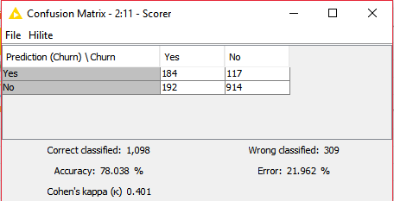
Evaluation
Using Cross-Validation to test the accuracy of the model, we apply our generated model on the test data to determine the accuracy of the model.
From our results, we can see that about 78% of the customer records were correctly classified.

Slide 27
Deployment

Slide 28
Deployment
The Deployment phase is the final phase in the CRISP-DM process. Here we will deploy our generated model.
In this phase of our project, the resultant analysis from our model is compiled in the form of simple-to-read reports and shared with the executive board of Telco Systems.
The results can help Telco Systems understand the factors as to why customers may unsubscribe from their services.
They can use that data to modify their existing services and business practices or launch new company initiatives to better entice customers to stay with their service.

Slide 29
Thank You!

Slide 30
References
Dataset obtained from www.kaggle.com/blastchar/telco-customer-churn
Software obtained from www.knime.com/knime-software/knime-analytics-platform

